Slide 1

AI-Enhanced Medical Imaging And Diagnostic Platform
Team Members
P.Suneel Kumar (Team Leader)
A.Mohan sai
C.Chiranjeevi
E.Vijaya Lakshmi
N.Vinod Kumar
R.Likitha
Y.Chandu

Slide 2
Introduction
Problem Statement
Challenges in Disease Diagnosis
Limited access to medical professionals in remote areas
Difficulty in diagnosing based on symptoms alone
Need for quick and accurate disease identification methods
Existing Solutions
Conventional methods: Text-based symptom checkers
Image-based diagnostics: X-ray analysis
Limitations of current systems: Lack of integration and real-time capabilities
Need for Improvement
Integration of multiple input types (text, audio, image)
Real-time analysis and accurate predictions

Slide 3
Introduction
Overview
This Platform integrates various inputs such as text, audio, live recordings, and images to identify conditions using advanced techniques, offering precise recommendations for medications, safety precautions, and follow-up care.
Automate processes such as data processing, image analysis, and text conversion to improve efficiency and reduce manual workload.
Offer advanced diagnostic capabilities and real-time health monitoring, particularly for remote areas or users with limited access to healthcare facilities
Objective
Multi-Modal Submission: Enable users to submit symptoms through text, audio, live recordings, or images for comprehensive analysis.
AI-Powered Disease Identification: Utilize machine learning models and natural language processing (NLP) techniques to provide accurate predictions and insights into potential health conditions based on user inputs.
User-Friendly Interface: Develop a responsive and accessible front-end to ensure ease of use, primarily within the local development environment, enhancing the overall user experience.

Slide 4
Project Architecture and Workflow
1. Input Processing
Text Input: The text is first cleaned using NLP techniques (e.g., removing stopwords, tokenization) and then translated to English if needed.
Audio Input: The audio is either recorded or provided as a file, converted to text using speech recognition, and then processed similarly to text input.
Image Input: Images are processed using a custom-trained model (pneumonia_detection_model.h5) to detect specific conditions like pneumonia. The result is then cross-referenced with the dataset for further details.
Live Recording: For audio, live recording captures real-time data and saves it as a file. he recorded file is then converted to text using speech recognition and processed similarly to text input.
2. Symptom Matching and Disease Identification
The cleaned and translated text is vectorized using TfidfVectorizer, and cosine similarity is calculated between the user input and the dataset's symptoms.
The system identifies the most similar disease based on this similarity score.

Slide 5
Project Architecture and Workflow
3. Disease Information Retrieval
Once a disease is identified, detailed information about the disease (e.g., symptoms, treatment plan, recommended medications) is retrieved from the combined dataset.
If needed, this information is translated back to the user's preferred language.
4. Output
The relevant disease information is formatted and printed in a clear and concise manner, ensuring all critical details are covered.
If no close match is found, the system prompts the user to try different symptoms.

Slide 6
Module: pyaudio
Classes Used:
pyaudio.PyAudio
pyaudio.Stream
Module: pydub
Class Used: AudioSegment
Module: speech_recognition
Class Used: Recognizer
Function Used: recognize_google
Module: opencv-python (cv2)
Function Used: cv2.imread
Module: pytesseract
Function Used: pytesseract.image_to_string
Module: tensorflow.keras
Custom-trained Model: pneumonia_detection_model.h5
Functions Used:
tensorflow.keras.preprocessing import image as keras_image
Function Used: tensorflow.keras.models.load_model
Module: sklearn.metrics.pairwise
Function Used: cosine_similarity
Module: pandas
Functions Used: pd.read_csv
Technologies Used
Natural Language Processing (NLP)
Audio Processing
Image Processing and Computer Vision
Machine Learning
Data Handling
Module and Functions Used
Module: nltk (Natural Language Toolkit)
Functions Used:
nltk.word_tokenize
nltk.corpus.stopwords
Module: sklearn.feature_extraction.text
Function Used: TfidfVectorizer
Module: langdetect
Function Used: detect
Module: deep_translator
Class Used: google translator

Slide 7
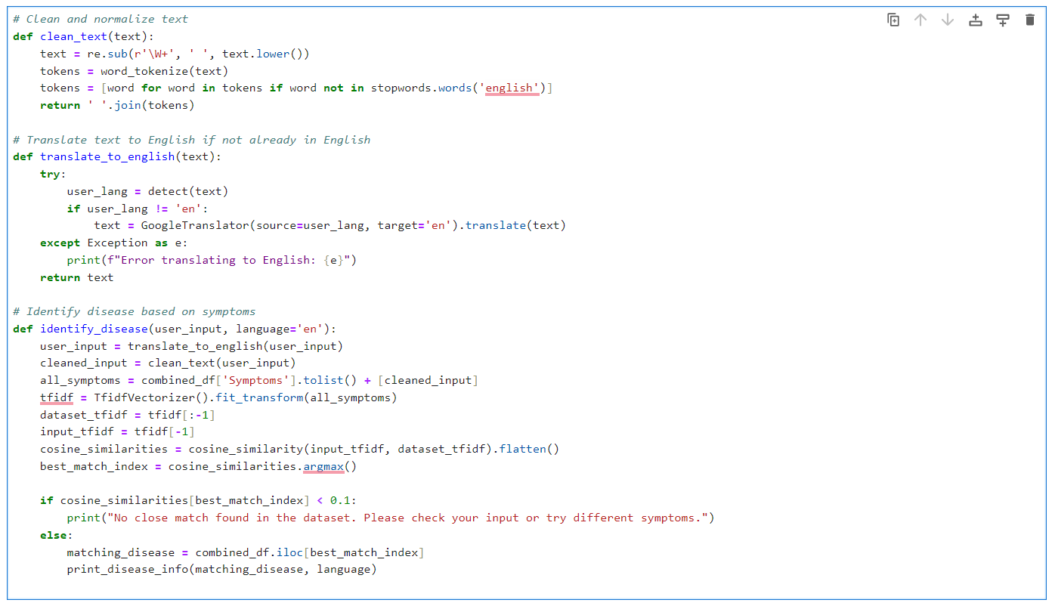
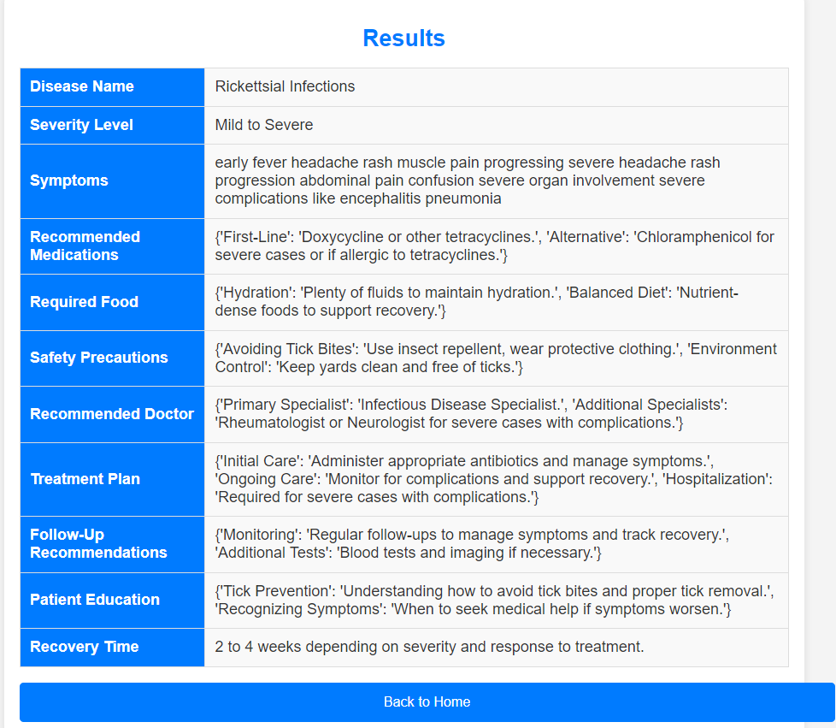
1. Text Processing and Disease Identification
Actions: Clean the text, detect language, translate if needed, vectorize, compute similarity with dataset, identify disease.
Input: User-provided text or symptom description
Output: Disease information.

Slide 8
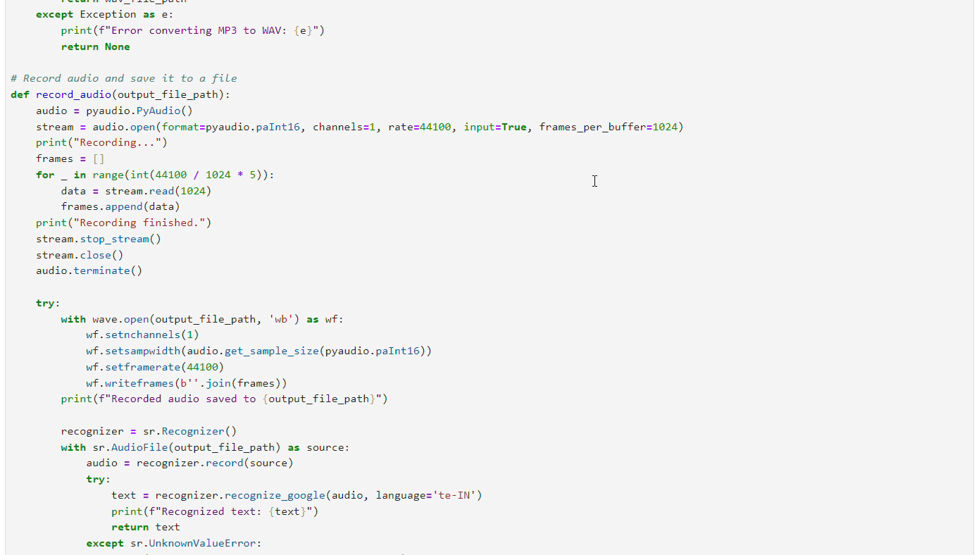
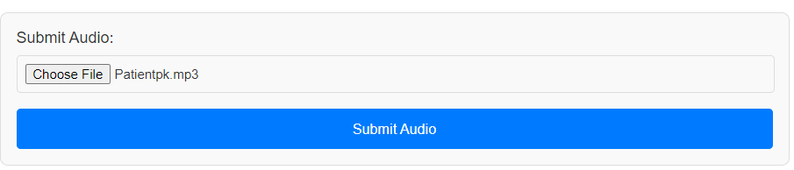
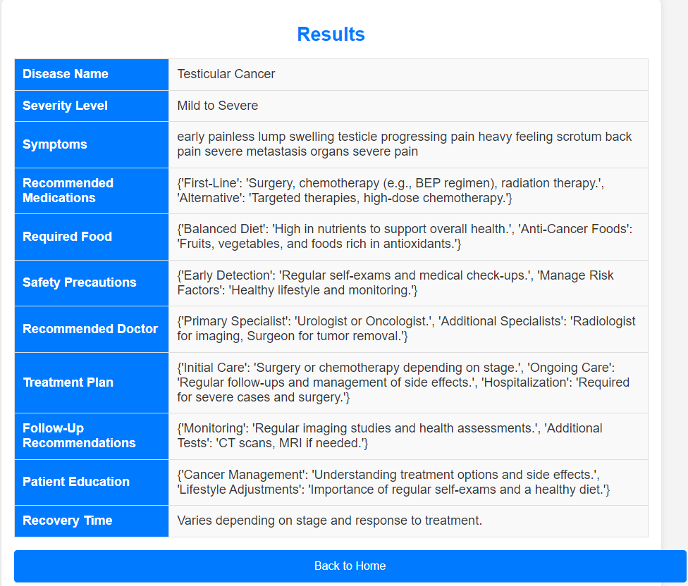
2. Live Record or Audio File Processing and Disease Identification
Actions: Convert MP3 to WAV if needed, recognize speech, translate if needed, process text for disease identification.
Input: Recorded audio or uploaded audio file.
Code snippet
Output: Disease information based on spoken symptoms.

Slide 9
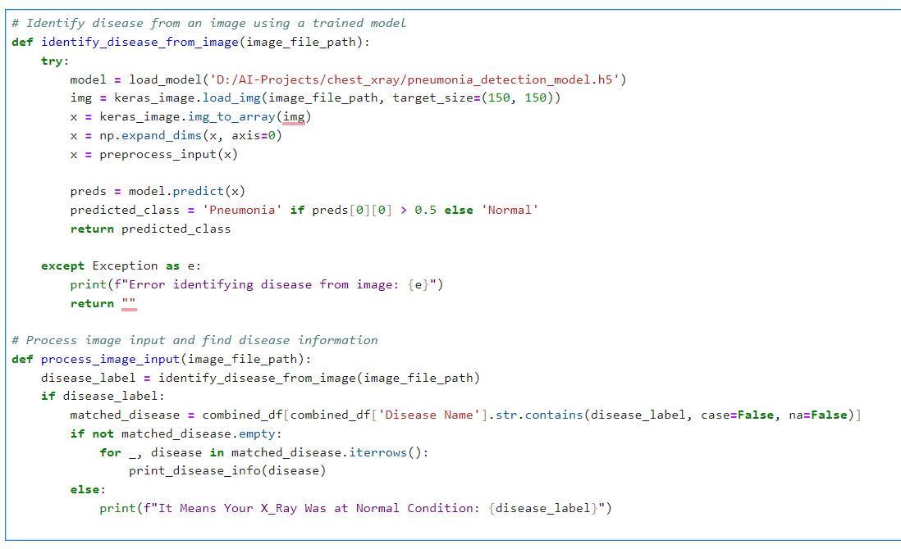
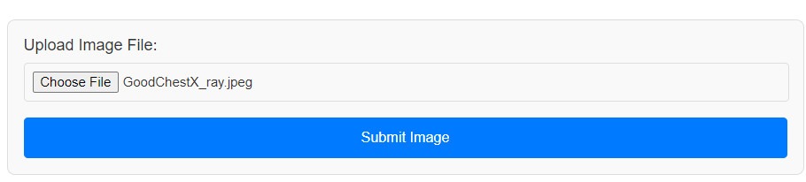
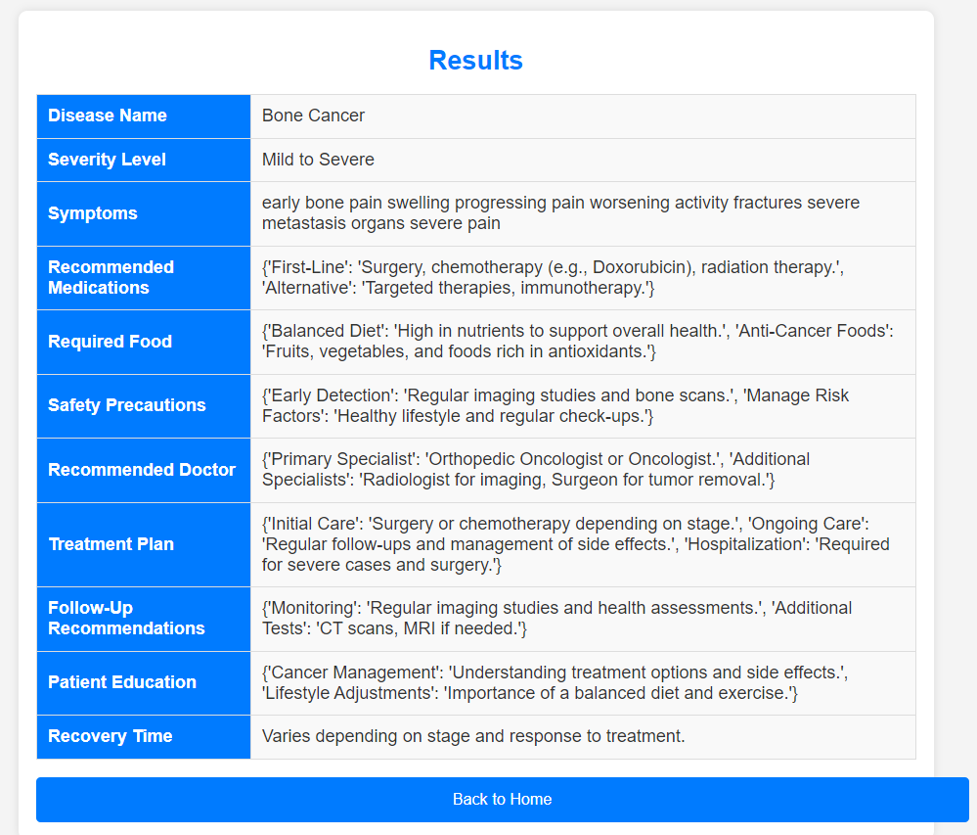
3. Image Processing and Disease Identification
Actions: Load and preprocess image, use trained model to predict disease, match prediction with dataset.
Input: Uploaded image (e.g., X-ray).
Output: Disease information or status.
Code snippet

Slide 10
Advantages And Disadvantages
Advantages
Real-Time Data: Captures and processes symptoms in real-time, offering immediate feedback.
Multi-Modal Capability: Supports text, audio, image, and live speech inputs for flexibility.
Interactive Features: Engages users through dynamic input methods, enhancing user experience.
Ease of Use: Streamlined processes for submitting symptoms and receiving feedback without complex procedures.
Cost Efficiency: Lowers healthcare costs by replacing physical diagnostic equipment by this enhanced platform.
Disadvantages
Audio Quality Issues: Background noise can impact transcription accuracy.
Processing Time: Audio takes longer to process compared to text.
Speech Recognition Errors: Misinterpretations can lead to incorrect analysis.
File Size: Larger audio files may slow upload times.
User Hesitation: Some users may be reluctant to record their voice.

Slide 11
Conclusion
This project leverages cutting-edge AI technology to transform the way we diagnose and manage diseases like pneumonia. By integrating machine learning, natural language processing, and computer vision, it provides a comprehensive solution for analyzing symptoms, processing audio recordings, and interpreting medical images.
The system enhances accuracy by detecting subtle patterns and early signs of disease, improving the chances of successful treatment. It supports multiple languages and automates diagnostic processes, making healthcare more efficient and reducing the workload on medical professionals. Additionally, it ensures faster and more accessible diagnostics, even in remote areas without on-site specialists.
Overall, this project aims to streamline healthcare, provide precise diagnoses, and offer personalized treatment recommendations, ultimately improving patient outcomes and making advanced medical care more widely available.

Slide 12
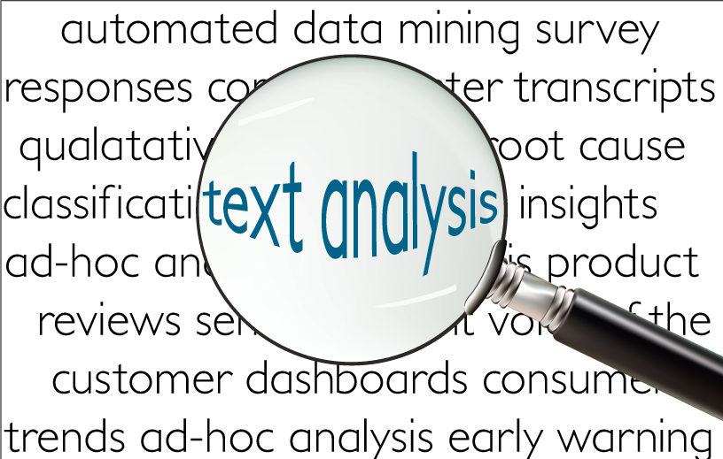
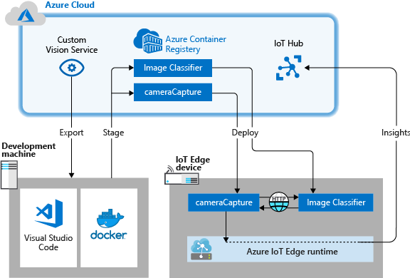
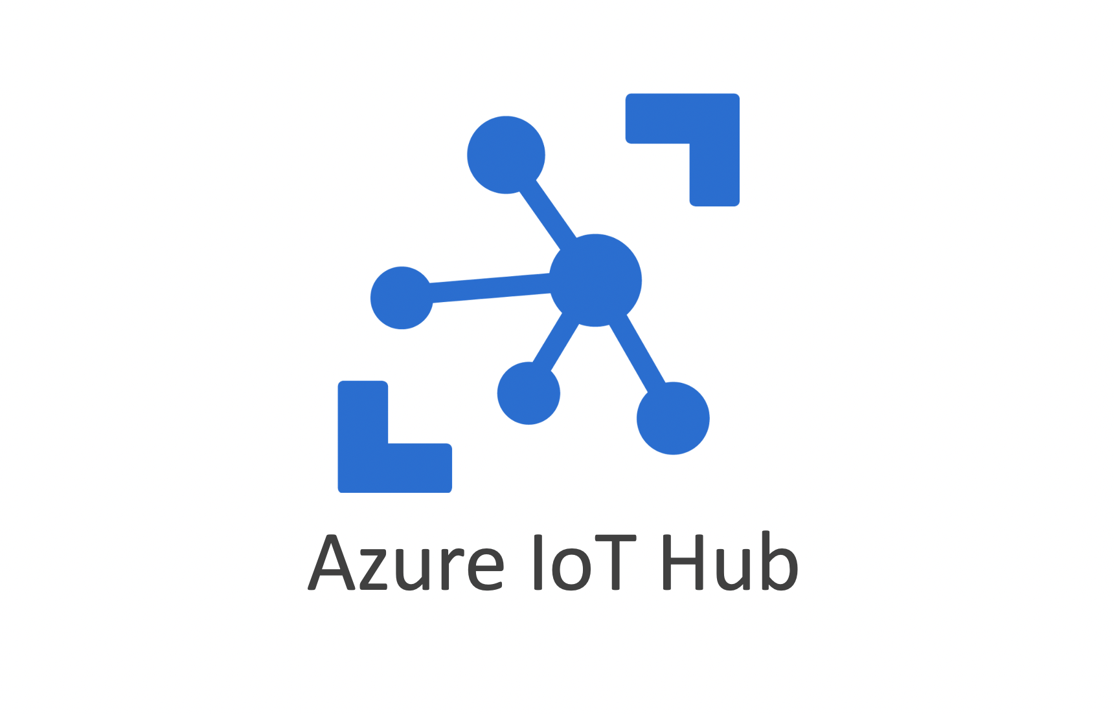
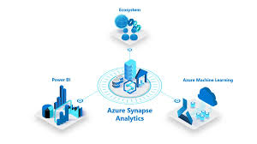

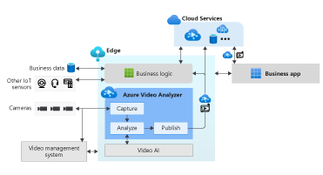
Future Enhance using Azure Services
Text Analytics
Azure IoT Hub
Custom Vision
Azure Synapse Analytics
Azure Kubernetes Service
Azure Video Analyzer

Slide 13

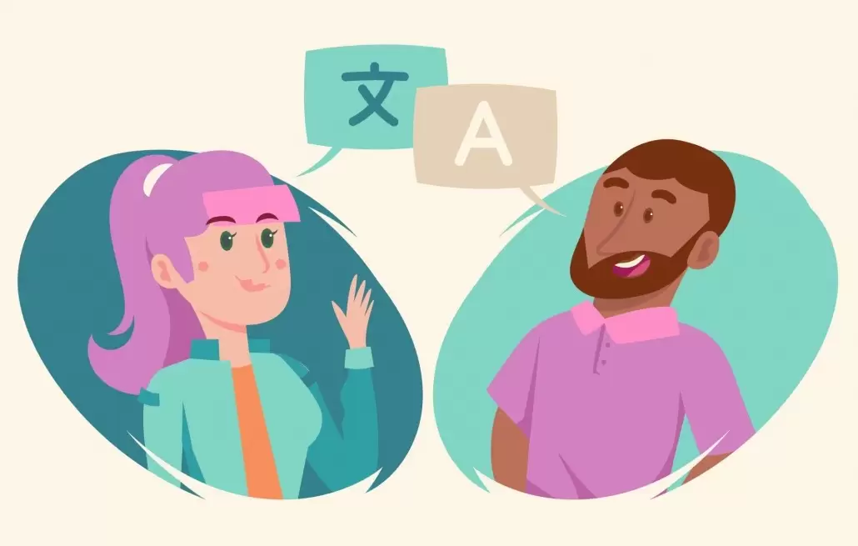
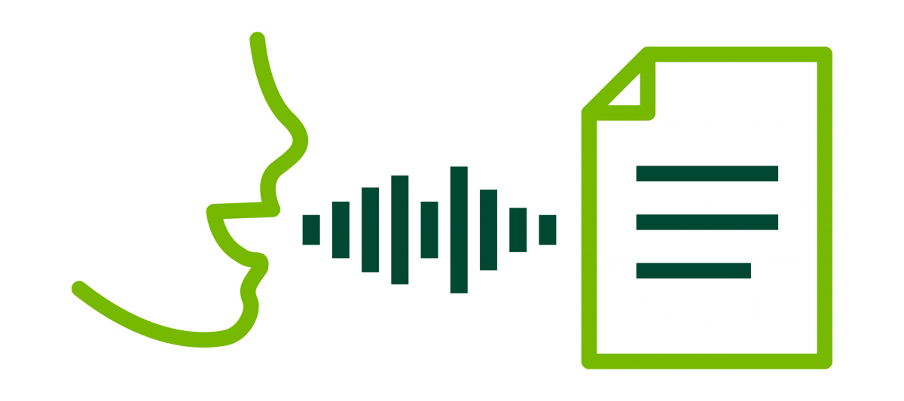
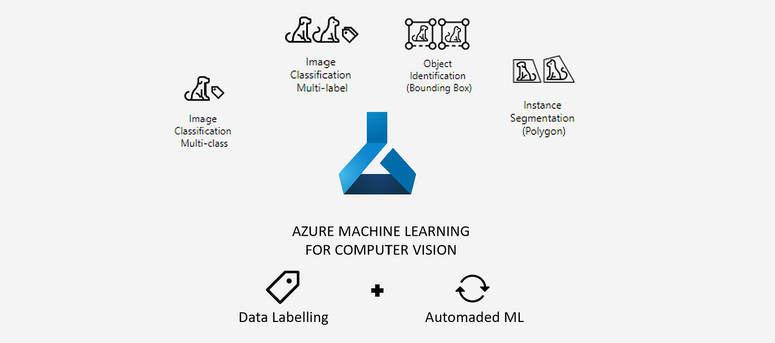
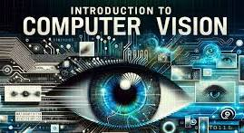

Future Enhance using Azure Services
Azure Blob Storage
Translator
Speech to Text
Azure Machine Learning
Computer Vision
Azure DevOps

